Slide 1
BUS7C1 CORPORATE STRATEGY AND INTERNATIONAL MANAGEMENT
Lecture 6: Core competencies, Business Models and Strategic Choices
Lecturer: Elan Kandaswamy

Slide 2

By the end of today you will be able to…
Explain core competencies and how they align to business strategy.
Assess business strategy of generic strategies and interactive strategies.
Identify and apply business model components and patterns

Slide 3
Core Competency Theory
Definition of Core Competency
A core competency is a unique strength that a company excels in, providing a competitive advantage.
It must be valuable, rare, and difficult to imitate.
Strategic Importance
Core competencies are fundamental to profitability and long-term success.
They allow a company to differentiate itself in the market.
Inside-Out Approach to Strategy
Unlike traditional strategies that focus on market conditions, this approach builds competitive advantage from internal strengths.
Businesses must develop and refine competencies over time.
Sustaining Competitive Advantage
To maintain core competencies, companies must continuously innovate and adapt to market changes.
If a core competency is lost, the company risks losing its competitive edge.
Notes:
Today, we are discussing Core Competency Theory, introduced by Hamel and Prahalad (1990). This theory emphasizes that a company's success is built on unique strengths—core competencies—which provide a competitive advantage. Unlike traditional "outside-in" approaches that focus on market positioning, this is an inside-out strategy, where the organization's internal capabilities drive success.
What is a Core Competency?
A core competency is something that:
Is unique – Competitors do not have it.
Adds value and increases profit – It directly contributes to the company's success.
Is difficult to imitate – Competitors cannot easily copy it.
Examples of Core Competencies
Apple – Design and Innovation
Apple’s ability to create sleek, user-friendly products with an integrated ecosystem (iPhones, Macs, AirPods) gives it a sustainable competitive advantage.
Other companies make smartphones, but Apple’s brand loyalty, software-hardware integration, and customer experience are hard to replicate.
Amazon – Logistics and Customer Service
Amazon’s efficient supply chain, vast distribution network, and customer-centric approach give it an edge in e-commerce.
Its ability to deliver products quickly and reliably makes it dominant in the market.
Toyota – Lean Manufacturing
Toyota developed the Toyota Production System (TPS), focusing on efficiency, quality, and waste reduction.
This has allowed Toyota to maintain cost advantages while ensuring high reliability, making it difficult for competitors to match.
Strategic Implications
Companies must identify, develop, and protect their core competencies.
Core competencies evolve with market changes. For example, Google’s core competency started with search algorithms but expanded into AI and cloud computing.
Competitive advantage is achieved by building core competencies faster and at a lower cost than competitors.

Slide 4
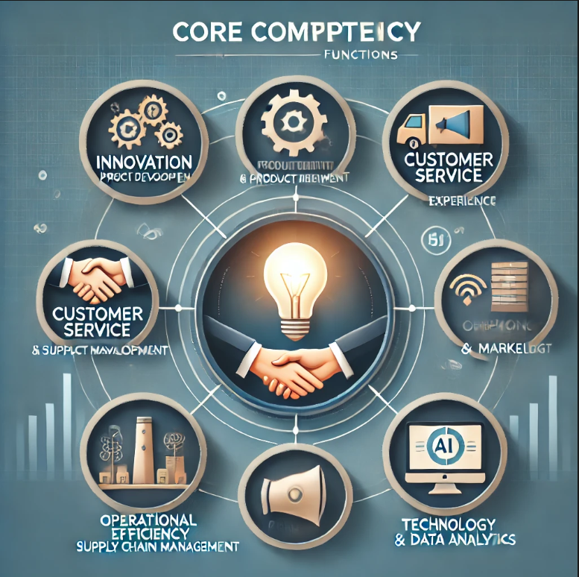
What functions might be a core competency?
Notes:
Innovation & Product Development
Example: Apple's design and technology innovation in the iPhone and MacBook.
Companies that consistently lead in R&D gain a strong competitive edge.
Customer Service & Experience
Example: Amazon’s fast delivery and customer-first approach.
Providing exceptional service can become a defining feature of a brand.
Operational Efficiency & Supply Chain Management
Example: Toyota’s Lean Manufacturing (Toyota Production System).
A highly efficient supply chain lowers costs and increases reliability.
Branding & Marketing
Example: Coca-Cola’s global brand recognition and emotional marketing.
Strong branding builds customer loyalty and differentiates a company.
Technology & Data Analytics
Example: Google’s search algorithm and AI-driven services.
Data-driven decision-making helps companies stay ahead of competitors.

Slide 5
So, how does this link to strategy?
Strategic Focus on Strengths
Businesses should build their strategy around their core competencies to maximize competitive advantage.
Sustainable Competitive Advantage
Core competencies create long-term differentiation by making it hard for competitors to imitate.
Investment & Resource Allocation
Companies should invest in and strengthen their core competencies through R&D, training, and infrastructure.
Adaptability & Market Growth
Core competencies must evolve with industry changes to maintain relevance and leadership.
By aligning strategy with core competencies, businesses capitalize on their strengths, innovate effectively, and maintain long-term success.
Notes:
Core competencies are directly linked to strategy because they shape how an organization competes, innovates, and grows. Here’s how:
1. Strategic Alignment with Core Competencies
When a company identifies its core competencies, it should align its business model and strategy around them.
Example: Apple focuses on design and innovation, so its strategy revolves around premium products, R&D investment, and ecosystem integration rather than cost-cutting.
2. Competitive Advantage through Differentiation
Strategy should emphasize what makes the company unique and hard to imitate.
Example: Nike uses branding and innovation (like Flyknit technology) to stay ahead rather than competing on price.
3. Resource Allocation & Investment
Organizations should invest in developing and strengthening their core competencies.
Example: Amazon prioritizes logistics and AI to improve delivery speed and customer experience, reinforcing its strategic edge.
4. Adaptability & Market Leadership
Core competencies should evolve with market trends and strategic goals.
Example: Google started with search algorithms but expanded into AI, cloud computing, and autonomous tech.
5. Business Model Design
Companies must design their business models around their strengths.
Example: Tesla’s core competency is battery technology and sustainable energy. Their direct-to-consumer sales model supports this, avoiding traditional dealerships.
Key Takeaway
To achieve long-term success, businesses should not just identify core competencies but continuously develop and integrate them into strategic decision-making. This ensures sustained competitive advantage and market leadership.
Would you like to discuss how this applies to a specific industry?

Slide 6

Business Strategy - making the right choice

Slide 7
Strategic choices
For the rest of the lecture, we will be looking at two key strategic choices.
What business strategy a company should choose
What business model a company or business unit should adopt in its market.
Business strategies are about how organisations compete in a marketplace i.e. a restaurant has to decide on food, menus, décor and prices which are dependent on the local market.
Business strategy is essential for all businesses both large and small however, the focus will be on larger, international organisations that are diversified in nature. These organisations will often contain decentralised ‘strategic business units’ in different product or market areas (they will have their own strategies).

Slide 8
Strategic Business Units (SBUs)
Strategic Business Units (SBUs) play a crucial role in organizational structure and strategy, particularly in large, diversified companies. An SBU is a distinct business unit within a larger organization, focused on a specific market, product line, or service area.
Notes:
Strategic Business Units (SBUs) play a crucial role in organizational structure and strategy, particularly in large, diversified companies. An SBU is a distinct business unit within a larger organization, focused on a specific market, product line, or service area.
Why Are SBUs Important?
SBUs allow companies to manage different parts of their business more effectively by:
Focusing on specific markets and customer needs.
Enabling independent strategy development.
Improving accountability by operating as profit centers.
Enhancing resource allocation for maximum profitability.
Types of SBUs
Small Business as a Single SBU
A small company typically operates as one strategic unit, handling all aspects of business under a single leadership team.
Example: A local bakery serves a specific market, manages its own supply chain, and tailors products to customer preferences.
Large Corporations with Multiple SBUs
Big companies often divide into separate SBUs based on products, markets, or capabilities.
Example: PepsiCo operates SBUs for beverages, snacks (Frito-Lay), and health-conscious products (Quaker Oats).
How to Identify SBUs
Market-Based Criteria:
Similar customers (e.g., Nike separates footwear, apparel, and accessories).
Similar distribution channels (e.g., Amazon operates retail, cloud computing (AWS), and streaming services separately).
Similar competitors (e.g., Toyota’s Lexus brand competes in the luxury segment, while Toyota competes in the mass-market segment).
Capabilities-Based Criteria:
Shared technology or skills (e.g., Google uses AI across multiple SBUs like search, cloud, and smart devices).
Similar operational processes (e.g., Unilever applies sustainability practices across different product categories).
Strategic Implications of SBUs
Autonomy in decision-making allows SBUs to respond quickly to market changes.
Resource allocation can be optimized to strengthen profitable business units.
Performance evaluation is easier, as each SBU is treated as a profit center.
Strategic Business Units help organizations balance specialization with corporate synergy, ensuring that different business segments operate efficiently while contributing to overall company success.

Slide 9
Discussion Questions
Can you think of a company with well-defined SBUs?
What are the advantages and challenges of managing multiple SBUs?
How do companies decide whether to keep SBUs separate or integrate them?
Notes:
1. Can you think of a company with well-defined SBUs?
Example: Unilever
Unilever has three main SBUs: Beauty & Personal Care, Foods & Refreshment, and Home Care.
Each unit operates independently with its own marketing, R&D, and supply chain strategy.
Example: Dove (Beauty & Personal Care) and Ben & Jerry’s (Foods & Refreshment) have different customers, competitors, and branding strategies, yet they all belong to Unilever.
Other examples:
Samsung: Mobile, Electronics, Semiconductors, and Home Appliances.
General Motors (GM): Chevrolet, Cadillac, Buick, and GMC all function as separate SBUs targeting different markets.
2. What are the advantages and challenges of managing multiple SBUs?
✅ Advantages:
Focused Strategy: Each SBU can tailor its approach to its specific market.
Better Resource Allocation: Profitable SBUs receive more investment, while struggling ones can be restructured.
Risk Diversification: A company with multiple SBUs can survive market downturns in one sector by relying on others.
❌ Challenges:
Coordination Issues: Managing multiple SBUs can lead to bureaucracy and inefficiencies.
Resource Conflicts: SBUs may compete for internal funding and strategic focus.
Brand Consistency Risks: If SBUs operate independently, they may lose synergies that strengthen the overall corporate identity.
3. How do companies decide whether to keep SBUs separate or integrate them?
Companies consider factors such as:
📌 Market Differences
If SBUs serve different customers or industries, they remain separate.
Example: Johnson & Johnson keeps its Pharmaceuticals, Medical Devices, and Consumer Health SBUs separate due to different regulations and target audiences.
📌 Operational Synergies
If SBUs can share R&D, supply chains, or technology, integration might be beneficial.
Example: Google integrated YouTube into its advertising ecosystem, leveraging data and AI for targeted ads.
📌 Brand Identity & Strategy
If an SBU has a strong independent brand, it remains separate.
Example: Facebook (Meta) kept Instagram and WhatsApp as distinct SBUs to preserve their unique user bases.
📌 Financial Performance
Companies may integrate struggling SBUs to reduce costs, or spin off successful ones for better focus.
Example: eBay spun off PayPal into a separate company to allow both businesses to grow independently.

Slide 10
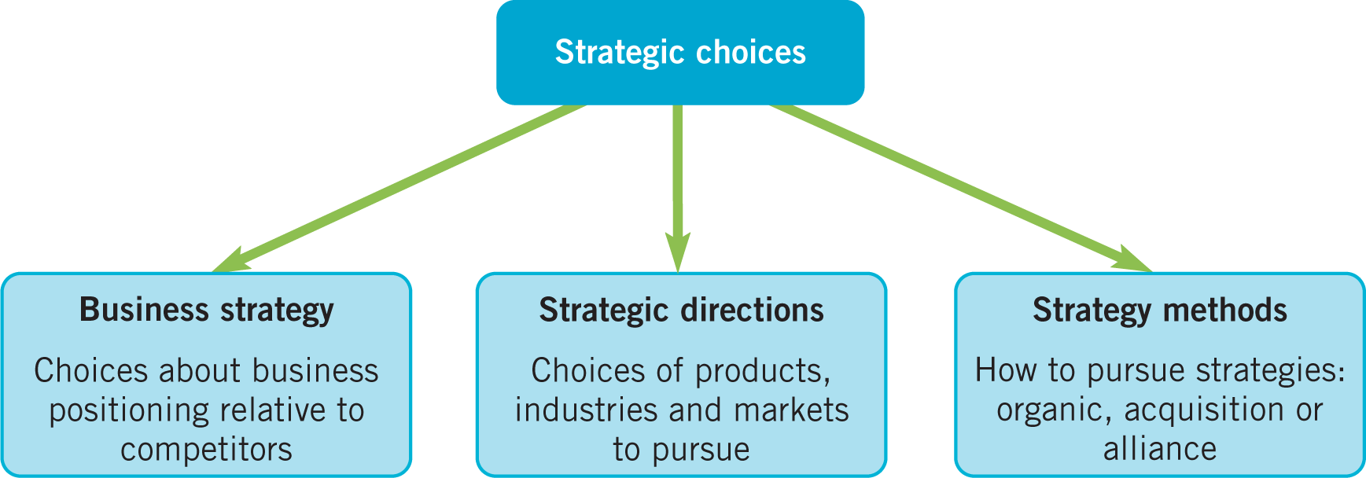
Strategic choices

Slide 11
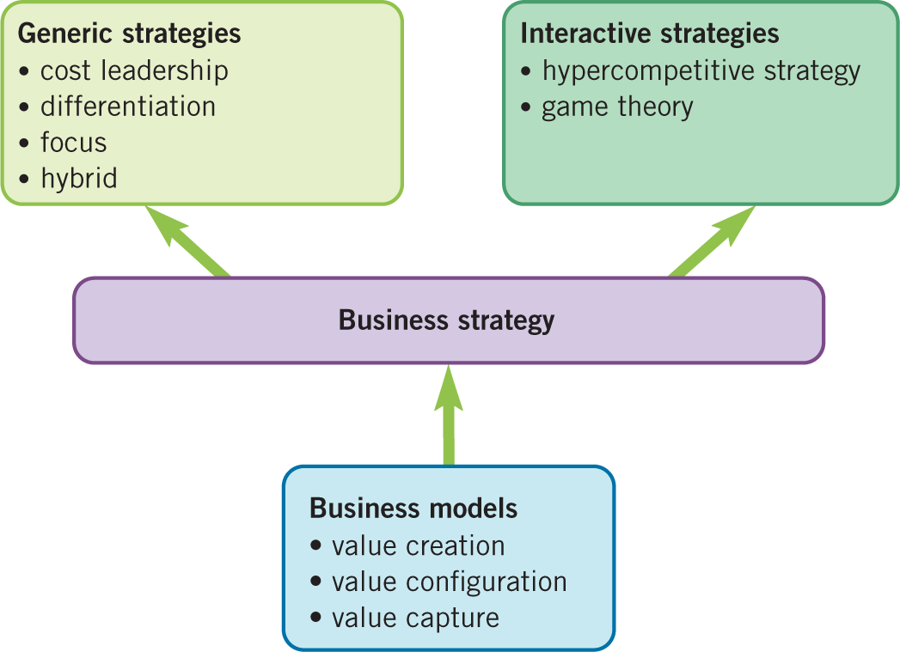
Business strategies and models

Slide 12
Generic competitive strategies
Michael Porter introduced generic strategies as fundamental approaches businesses can use to gain a competitive advantage. These strategies apply across industries and business types, helping companies differentiate themselves and succeed in their market.
Notes:
Michael Porter introduced generic strategies as fundamental approaches businesses can use to gain a competitive advantage. These strategies apply across industries and business types, helping companies differentiate themselves and succeed in their market.
1. What is Competitive Strategy?
Competitive strategy focuses on how an organization achieves a superior position in its industry. It is about delivering greater value to customers while maintaining a cost advantage over competitors.
2. Porter’s Three Generic Strategies
Porter identified three main competitive strategies that businesses can use:
A. Cost Leadership (Being the Lowest Cost Producer)
A company competes by offering lower prices than rivals while maintaining profitability.
Requires efficient production, economies of scale, and cost-cutting without sacrificing quality.
Example: Walmart dominates retail by focusing on low-cost supply chains, bulk purchasing, and efficient logistics.
B. Differentiation (Being Unique in a Valuable Way)
A business competes by offering a unique product or service that customers value and are willing to pay more for.
Requires strong branding, innovation, and superior customer service.
Example: Apple differentiates through high-quality design, innovation, and seamless product integration, allowing it to charge premium prices.
C. Focus Strategy (Targeting a Niche Market)
This can be split into:
Cost Focus: Offering lower prices in a specific segment (e.g., Aldi’s low-cost grocery model).
Differentiation Focus: Offering unique products/services to a niche market (e.g., Rolex in the luxury watch market).
3. How Does This Create Competitive Advantage?
Cost Leadership → Competes on Price (More customers due to affordability).
Differentiation → Creates Brand Loyalty (Customers are willing to pay more).
Focus Strategy → Specialization in a Profitable Niche (Less direct competition).
4. Strategic Considerations
Companies must choose one dominant strategy—trying to be both low-cost and differentiated can lead to being "stuck in the middle."
Competitive strategies must evolve with market trends, technological advancements, and customer preferences.
Sustaining competitive advantage requires constant innovation and strategic investment.
By understanding and applying Porter’s generic strategies, businesses can develop a clear competitive edge, attract customers, and ensure long-term profitability.

Slide 13
Cost-leadership strategy
Cost-leadership strategy involves becoming the lowest-cost organisation in a domain of activity.
Four key cost drivers that can help deliver cost leadership:
Economies of scale.
Experience.
Lower input costs.
Product/process design.
Notes:
The cost-leadership strategy is a competitive approach where a company seeks to be the lowest-cost producer in its industry or market segment. The goal is to attract price-sensitive customers and gain a competitive advantage by offering goods or services at a lower price than competitors while maintaining profitability. This is particularly effective in industries with high price competition or where customers make purchasing decisions primarily based on price.
To implement a successful cost-leadership strategy, organizations focus on four primary cost drivers:
1. Economies of Scale:
Economies of scale occur when a company’s production increases, and as a result, the cost per unit decreases. This is typically achieved by increasing the volume of production, which spreads fixed costs over more units of output, reducing the cost per unit.
Impact on Cost Leadership:
Reduced production costs: As companies expand their operations and increase production, they can negotiate better deals with suppliers and reduce costs related to labor, raw materials, and overheads.
Increased bargaining power: Larger companies can leverage their scale to negotiate lower prices with suppliers and benefit from bulk purchasing.
Example: Walmart is an excellent example of a company that has achieved cost leadership through economies of scale. Walmart’s massive supply chain network allows it to keep costs low and pass those savings onto customers, making it a low-price leader in retail.
Risks/Challenges:
Overcapacity: There’s a risk of producing more than the market can absorb, leading to excess inventory or unutilized capacity, which can strain finances.
High fixed costs: In some cases, companies may invest heavily in infrastructure and equipment to achieve economies of scale, which can create high fixed costs. If demand falls, these fixed costs become a burden.
2. Experience (Learning Curve Effects):
The experience curve refers to the phenomenon where the more a company produces a good or service, the more efficient it becomes at producing it. As workers, processes, and systems become more efficient over time, the cost per unit decreases, driven by accumulated knowledge and practice.
Impact on Cost Leadership:
Reduced labor costs: As employees become more skilled and processes become more streamlined, labor costs decrease.
Improved operational efficiency: Experience leads to better use of resources, reduced wastage, and quicker production cycles, which helps to drive down costs.
Example: McDonald's benefits from experience in its standardized production methods and operational efficiency across thousands of locations globally. The company has honed its operations over time to provide quick and inexpensive meals, contributing to its low-cost advantage.
Risks/Challenges:
Complacency: Companies may become complacent over time and fail to innovate or keep improving their processes, leading to stagnation.
Market changes: The experience curve is based on a stable process. If customer demands or technologies change, the company's experience advantage may not be transferable to the new environment.
3. Lower Input Costs:
Lower input costs are achieved by reducing the price of raw materials, labor, and other resources required to produce goods or services. Cost leadership is often heavily reliant on securing cheaper input costs, which can be done through supplier relationships, outsourcing, or finding alternative resources.
Impact on Cost Leadership:
Negotiating power: Companies can use their purchasing power to negotiate lower prices with suppliers, reducing the overall cost of production.
Global sourcing: Companies may seek to reduce costs by sourcing materials from regions where labor and production costs are lower, a strategy often referred to as outsourcing or offshoring.
Example: IKEA leverages lower input costs through its global sourcing strategy, finding low-cost suppliers in various countries while maintaining affordable prices for customers. Its ability to keep production costs low while offering stylish, functional furniture has been key to its cost-leadership strategy.
Risks/Challenges:
Quality issues: Lowering input costs can sometimes compromise product quality, especially if cheaper materials or labor are used in production. This can harm the company’s reputation and lead to customer dissatisfaction.
Dependence on suppliers: Companies that rely heavily on low-cost suppliers might become vulnerable to supply chain disruptions, price fluctuations, or changes in the political or economic landscape of supplier countries.
4. Product/Process Design:
Product and process design refers to creating products that are easy and inexpensive to produce while still meeting customer needs. Streamlining the design and production process can help reduce costs and improve efficiency.
Impact on Cost Leadership:
Simplified production processes: Companies can design products in ways that simplify manufacturing, reduce material costs, and improve efficiency.
Standardization: By producing standardized products or using modular designs, companies can reduce complexity, which helps to lower costs.
Example: Toyota has long been known for its focus on process design through the Toyota Production System (TPS), which emphasizes eliminating waste, improving efficiency, and ensuring that products are made with the least amount of resources possible. This approach has contributed to Toyota's ability to produce vehicles at a lower cost while maintaining quality.
Risks/Challenges:
Inflexibility: Overly focusing on cost-efficient designs might limit innovation or the company’s ability to quickly adapt to changing consumer preferences or technological advancements.
Limited differentiation: A focus on low-cost design might lead to products that are seen as less innovative or lower quality compared to those offered by competitors pursuing differentiation strategies.
Conclusion:
The cost-leadership strategy can be highly effective in markets where price sensitivity is a key factor in customer decision-making. By leveraging economies of scale, experience, lower input costs, and efficient product/process design, companies can position themselves as cost leaders in their industries. However, achieving cost leadership comes with its own set of risks, such as quality concerns, vulnerability to market changes, and the challenges of maintaining low costs while still meeting customer expectations. For businesses to successfully execute and sustain this strategy, they must continue to innovate and streamline operations while carefully managing these risks.
4o mini

Slide 14
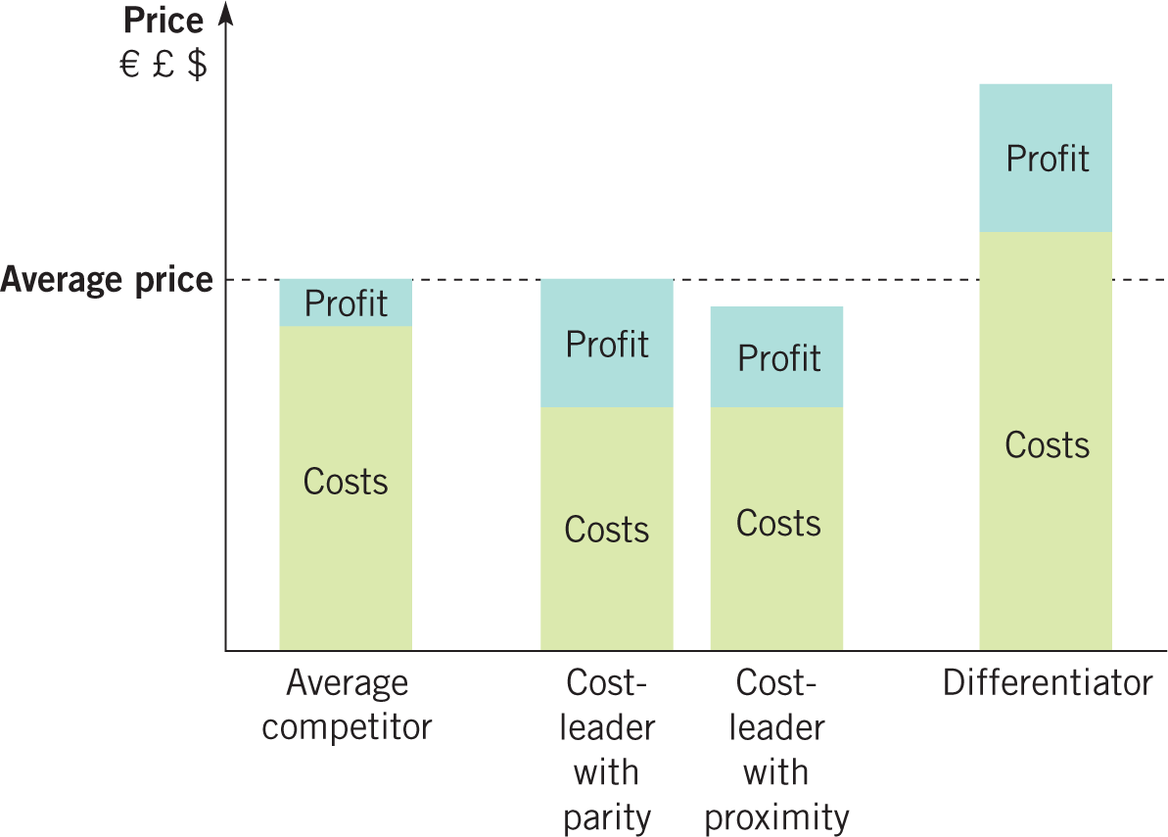
Costs, prices and profits for generic strategies
Low cost should not be pursued in total disregard for quality. Businesses have two options here:
Parity – equivalent quality in terms of product or service features. The cost leader can then charge to the same price as rivals and make higher profits.
Proximity – only slightly lower quality allows the cost leader to offer a slightly lower price and still make higher profits.
Notes:
While pursuing a cost-leadership strategy, companies must strike a balance between maintaining low costs and ensuring that the quality of their products or services remains acceptable. If a business cuts costs to the point of sacrificing quality significantly, it risks losing customers and damaging its brand reputation. Therefore, companies have two strategic options to manage this trade-off: Parity and Proximity.
1. Parity: Equivalent Quality with Competitors
In the parity approach, the cost leader offers products or services with quality equivalent to that of competitors, even if its cost structure is lower. This means that the company manages to keep its operational costs down but doesn't reduce the product’s quality compared to what rivals are offering. In this case, the cost leader can charge the same price as competitors but still make higher profits due to its lower production or operational costs.
Advantages of Parity:
Competitive Pricing with No Compromise on Quality: By offering a product of equal quality to competitors but at a lower cost, the company has the opportunity to attract price-sensitive customers while maintaining a reputation for delivering value.
Enhanced Profit Margins: Because of its lower cost base, the company can enjoy better profit margins even if the selling price is the same as competitors. This creates a competitive advantage without sacrificing customer satisfaction.
Brand Loyalty and Trust: Since the company offers similar quality to its competitors, customers are less likely to perceive it as "cheap" in a negative sense. This can build trust and encourage repeat business, even among customers who care about quality.
Example of Parity:
Aldi in the retail sector can be considered a good example. Aldi offers products that are comparable in quality to traditional grocery stores but at significantly lower prices. They achieve this through their operational efficiency, limited selection, and streamlined supply chain. Customers may pay the same price as they would at other stores for similar items but are drawn to Aldi for the lower prices.
Challenges of Parity:
Operational Efficiency Is Crucial: To ensure profitability with parity, a company must have exceptional operational efficiency and cost control. Without this, the benefits of lower costs could quickly erode.
Pressure to Maintain Quality: If the quality dips below what is expected in comparison to competitors, the company could risk losing customers, especially those who value product quality.
Market Saturation: In industries with intense price competition, it may be hard for a company to maintain parity over the long term, especially if larger competitors have deeper pockets.
2. Proximity: Slightly Lower Quality for a Slightly Lower Price
The proximity strategy involves offering a product or service with slightly lower quality than competitors, but in return, the company can charge a slightly lower price. The slight quality difference can be in terms of product features, durability, or customer service, but the value proposition to customers is the cost advantage.
Advantages of Proximity:
Price Differentiation: The company can attract customers who are willing to sacrifice a small amount of quality for a lower price. This is often effective in markets where customers prioritize affordability over premium features or services.
Clear Market Niche: The proximity strategy allows businesses to clearly differentiate themselves from higher-end competitors by being the budget-friendly option. This can appeal to a large segment of price-sensitive customers, especially in industries like retail or consumer electronics.
Higher Profitability through Cost Efficiency: By accepting a small reduction in quality, the business can offer lower prices while still maintaining a cost advantage. This can result in higher sales volumes and better profitability.
Example of Proximity:
Southwest Airlines is a good example of the proximity strategy in action. Southwest offers budget flights with basic services, compared to premium airlines. It focuses on cost-efficiency by operating a point-to-point route network, minimizing frills (like meals and entertainment), and maintaining a no-frills approach, but still delivers a reliable and affordable flight experience.
Value Brand Smartphones like OnePlus also follow a proximity strategy. They offer smartphones that are slightly lower in terms of premium features compared to top-tier brands like Apple and Samsung but come at a significantly lower price.
Challenges of Proximity:
Risk of Perceived Inferiority: Even a small reduction in quality can lead to customers perceiving the product as inferior, especially if the company’s offerings are seen as “cheap” or “low-quality.” This can lead to a loss of brand reputation.
Difficult to Compete on Quality Alone: If the market becomes saturated with alternatives offering better quality at a slightly higher price, the company may find it harder to maintain its position.
Limited Customer Segments: Customers willing to compromise on quality for price may be a smaller segment, meaning the company could be limiting its potential customer base.
Which Approach is Right?
The choice between parity and proximity largely depends on the market, customer preferences, and the company’s operational model. Here’s a brief comparison:
Parity works best in markets where customers are quality-conscious but also price-sensitive. Offering the same level of quality as competitors allows the company to attract a broad customer base, and the lower cost base helps maintain higher profits.
Proximity is more effective in markets where customers are more willing to trade-off a little quality for a price advantage. This can work well in industries where functional differences matter more than premium features.
Conclusion:
While pursuing a cost-leadership strategy, businesses must ensure that they do not completely disregard quality, as this could drive away customers. The key lies in finding the right balance between cost reduction and quality maintenance. The parity approach allows a business to offer equivalent quality at a lower cost, making it an appealing option for a wide range of customers, while the proximity approach can be effective for those who are willing to accept slightly lower quality in exchange for a lower price. Both strategies have their merits, but the ultimate goal is to offer a competitive advantage through cost leadership while still delivering acceptable value to customers.

Slide 15
Differentiation strategy
Differentiation involves uniqueness along some dimension that is sufficiently valued by customers to allow a price premium.
Within each market businesses may differentiate along different dimensions.
Two key issues to consider:
The strategic customer on whose needs the differentiation is based.
Key competitors – who are the rivals and
who may become a rival.
Notes:
The differentiation strategy is one of the key components of Michael Porter's competitive strategies, focusing on creating a unique offering that stands out in the marketplace. This uniqueness allows businesses to charge a premium price, as customers are willing to pay more for something they perceive as offering greater value. However, implementing a successful differentiation strategy requires a deep understanding of the market, customers, and competitors. It’s not just about being different; it’s about being different in ways that customers truly value.
The differentiation strategy typically involves creating products or services that stand out from the competition by offering something special. It could be related to features, design, technology, quality, customer service, brand, or other elements that influence consumer perceptions. Companies using this strategy typically aim to capture a niche market that values their unique offering enough to pay a higher price.
Key Issues to Consider:
1. The Strategic Customer: Whose Needs Are You Addressing?
To succeed with a differentiation strategy, companies must first identify and deeply understand their strategic customers. These are the target customers whose needs and preferences drive the demand for the differentiated product or service.
Identifying the Right Customer Segment: Differentiation strategies typically succeed when businesses focus on a customer segment that places high value on the specific qualities they are offering. This could be premium features, brand prestige, unique experiences, or innovation that meets unmet needs.
For example:
Apple focuses on tech-savvy consumers who value aesthetics, ease of use, and the seamless integration of their devices.
Tesla caters to environmentally conscious buyers looking for high-performance electric cars that are also sustainable.
Understanding Customer Needs: Businesses must identify the pain points or desires of their strategic customers that are not being addressed by competitors. The uniqueness offered by the company should solve a problem, improve the customer’s life, or provide something they cannot find elsewhere in the same way.
For instance:
Patagonia differentiates by offering eco-conscious consumers high-quality outdoor clothing that is also sustainably made, aligning with the values of its target customer base.
Customer Willingness to Pay a Premium: To justify a price premium, the differentiation must be meaningful to customers. This means the company needs to understand what customers value most, whether that is product performance, design, brand reputation, or customer service.
For example, Rolex customers are willing to pay a premium not just for the functional qualities of the watch but for the brand prestige and perceived luxury that come with owning a Rolex.
Risk of Over-Differentiation: It’s crucial to balance differentiation with practicality. A product that is too different or too niche may fail to capture enough market share, and if the added features are not valued by the customer, they may not be willing to pay the premium price. Over-differentiating without customer backing can lead to a mismatch between what the company offers and what customers actually want.
2. Key Competitors: Who Are the Rivals and Who Might Become Rivals?
In any competitive market, understanding both current and potential competitors is crucial when executing a differentiation strategy. Not only must a company evaluate who its direct competitors are, but it must also anticipate who might enter the market or shift their strategy to compete more effectively.
Current Competitors: These are the businesses that are already offering products or services similar to yours. Differentiation helps to set your offering apart from theirs, but you need to constantly monitor what competitors are doing to stay ahead.
For example, Samsung competes directly with Apple in the smartphone and technology space. While both offer premium devices, Samsung differentiates with a focus on cutting-edge features like curved screens, high-resolution cameras, and larger screen sizes.
Potential Competitors: A critical aspect of differentiation is understanding who might enter the market or shift from other areas of the business to directly compete. Competitors who are not currently offering differentiated products may decide to shift their strategies to focus on differentiation. This could be through innovation or by copying the features that have proved successful in the market.
For instance, Xiaomi, originally known for producing budget smartphones, has increasingly introduced differentiated products with high-end specifications, targeting premium customers. By doing so, it became a potential competitor to established brands like Apple and Samsung.
Emerging Competitors: Businesses need to stay aware of market trends and emerging competitors. New entrants may bring innovative differentiation models to the market, which could threaten established players. In industries like technology and fashion, where consumer preferences shift quickly, established companies must be agile and ready to react to potential new rivals.
Differentiation and Competitive Advantage: By creating a differentiated product or service, a company can potentially create a competitive advantage that rivals find difficult to replicate. However, the more successful the differentiation, the more likely it is that competitors will try to imitate it. Therefore, businesses must continue to innovate and find new ways to maintain their unique position.
For example, Nike differentiates itself with a focus on branding and innovation in athletic wear. However, its competitors, like Adidas and Under Armour, are constantly innovating and trying to catch up in terms of technology and brand loyalty.
Sustaining Differentiation: In the face of competition, it’s essential for businesses to consistently innovate and adapt to customer preferences to sustain their differentiation. Continuous investment in R&D, branding, and customer relationships will help maintain the uniqueness of their offerings and ensure that customers continue to value the product enough to justify paying a premium price.
Balancing Differentiation and Competitiveness
Differentiation strategies work best when a company can clearly define its niche and build a loyal customer base willing to pay for the unique attributes the company offers. However, companies must always remain vigilant about competitors and market trends to ensure that their differentiation remains sustainable and relevant.
Keeping the Focus on the Customer: It’s important that businesses continuously engage with their customers to ensure that their differentiated offering remains aligned with customer desires. In a rapidly changing market, what differentiated a product today may no longer be as appealing tomorrow.
Dynamic Competition: The key competitors and market dynamics in a differentiation strategy are fluid. Rivals may attempt to copy differentiated features, or new entrants might disrupt the market with more innovative or cost-effective differentiation strategies. To stay ahead, businesses must be ready to adapt, evolve, and continuously innovate.
Conclusion:
To successfully implement a differentiation strategy, businesses must deeply understand the needs of their strategic customers and ensure that their unique value proposition is clearly communicated and appreciated. By focusing on what customers value most (e.g., quality, performance, design, brand, etc.), companies can justify a price premium and carve out a strong competitive position in the market. However, businesses must also stay vigilant about current and potential competitors, continuously innovating to stay ahead and maintaining a sustained competitive advantage. Balancing differentiation with a clear understanding of customer needs and competitor behavior is key to long-term success.

Slide 16
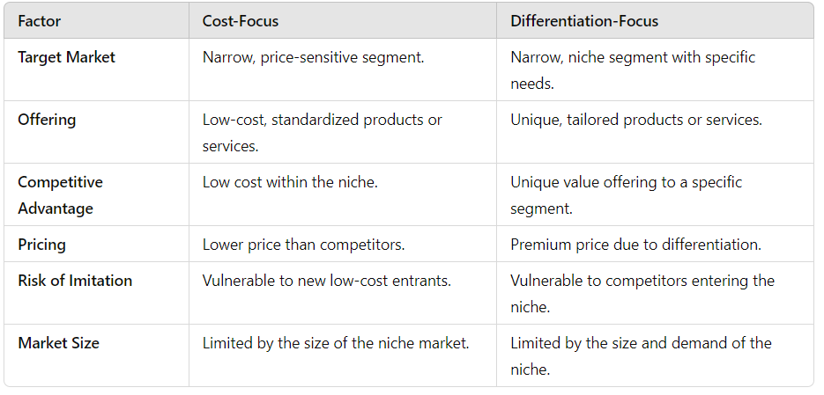
Focus strategy
Notes:
A focus strategy is one of the competitive approaches in Michael Porter’s framework that involves concentrating on a specific market segment or niche rather than trying to appeal to the broader market. This strategy is based on tailoring products, services, or marketing efforts to meet the particular needs of a narrowly defined customer group. By focusing on a specific domain of activity, businesses can serve their target market more effectively than competitors who adopt broader strategies.
There are two types of focus strategies: cost-focus and differentiation-focus. Both aim at a specific market segment but achieve their goals using different approaches — cost leadership or differentiation.
1. Cost-Focus Strategy
A cost-focus strategy is a variation of the cost-leadership strategy, but with a narrower scope. Instead of aiming to be the lowest-cost producer in the entire market, the company focuses on being the lowest-cost producer within a specific, targeted niche. This allows the company to cater to the unique needs of a particular segment at a lower cost than competitors who serve a broader market.
Example: Ryanair Ryanair is a well-known example of a company that employs a cost-focus strategy. It operates as a low-cost airline, targeting budget-conscious travelers in Europe. Ryanair focuses on a narrow segment of the airline market: customers who are looking for the cheapest possible flights and are willing to forgo premium services (such as in-flight meals or entertainment) in exchange for lower fares. By streamlining operations, minimizing overhead, and charging for additional services (like luggage), Ryanair is able to provide low-cost air travel while targeting the specific segment of budget travelers.
Key Features of a Cost-Focus Strategy:
Narrow Target Market: The company targets a very specific group of customers who are price-sensitive or have particular needs that can be met with a lower-cost offering.
Efficiency in Operations: The business must maintain efficiency and operational effectiveness to ensure that cost leadership can be achieved within the chosen segment.
Standardization: Offering basic, standardized products or services that meet the essential needs of the niche without adding unnecessary costs.
Advantages of Cost-Focus:
Competitive Advantage in the Niche: By targeting a specific customer segment, the company can achieve economies of scale and cost advantages that competitors serving a wider market might not achieve.
Customer Loyalty: Budget-conscious customers in the focused segment may develop strong brand loyalty due to the company’s affordability and specialization in their needs.
Challenges of Cost-Focus:
Vulnerability to New Entrants: The low-cost model might attract new entrants who want to serve the same niche, leading to increased competition and reduced margins.
Limited Market Growth: Since the focus is on a narrow segment, there may be limited opportunities for expansion beyond that segment without compromising the cost leadership.
2. Differentiation-Focus Strategy
A differentiation-focus strategy is similar to the differentiation strategy, but it is targeted at a specific niche or segment of the market. Companies using this approach differentiate their offerings in ways that are tailored to the needs or preferences of a particular group of customers, rather than aiming to offer unique products for a broad market. The goal is to provide something highly specific and valuable to the target segment, which can command a premium price.
Example: Ecover (Ecological Cleaning Products) Ecover is a prime example of a company that uses a differentiation-focus strategy. Ecover focuses on the niche market of environmentally conscious consumers who want eco-friendly, sustainable, and non-toxic cleaning products. Unlike mass-market cleaning brands, Ecover tailors its products to meet the specific needs of this group by offering products made from natural, biodegradable ingredients, and by emphasizing sustainability in production and packaging.
Key Features of a Differentiation-Focus Strategy:
Targeted Differentiation: The company tailors its product or service offering to the specific preferences or needs of a narrowly defined customer group, creating a unique value proposition that resonates deeply with that segment.
Premium Pricing: Since the company is offering differentiated products that are valued by the niche segment, it can charge higher prices for its offerings.
Brand Identity and Loyalty: A strong brand identity focused on the unique needs of the target market helps build customer loyalty and enhances the perceived value of the offering.
Advantages of Differentiation-Focus:
High Customer Loyalty: By tailoring offerings to the specific needs of a niche market, the company can create strong emotional bonds with customers, leading to loyalty and repeat business.
Pricing Power: Because the product or service is highly differentiated and tailored, businesses can charge a premium price for the uniqueness it offers to the target segment.
Less Direct Competition: By serving a niche with specific needs, the company faces less direct competition from broad-market competitors.
Challenges of Differentiation-Focus:
Limited Market Size: The niche market may not be large enough to generate significant revenue or growth opportunities, which can limit long-term success.
Risk of Imitation: Competitors outside the niche may notice the success of a differentiated offering and attempt to enter the niche with their own versions of the product, diluting the uniqueness of the offering.
Market Sensitivity: The focus on a specific segment means that changes in consumer preferences or economic conditions within that segment can significantly affect sales.
A focus strategy is a powerful way for companies to establish a competitive position by serving a specific market segment, whether through cost-focus or differentiation-focus. The focus is on narrowing the scope of the target market, which allows businesses to tailor their offerings to better meet the unique needs of that group.
Cost-focus works well for companies that can achieve significant cost advantages and offer low-priced products to a specific, price-sensitive market.
Differentiation-focus, on the other hand, is effective for businesses that offer unique, specialized products or services that are highly valued by a smaller but loyal customer base, justifying a premium price.
While both strategies can be highly effective, businesses need to carefully consider the size of the target segment, potential for growth, and risks of imitation from larger competitors. The key to success lies in deeply understanding the needs of the target market and crafting an offering that is truly valued by that segment.

Slide 17
Hybrid strategy
Apple:
Cost leadership: Apple benefits from economies of scale in its production and has efficient supply chain management, which helps it reduce costs.
Differentiation: Apple also differentiates through its premium design, software ecosystem, brand loyalty, and high-end features.
Hybrid in Action: While Apple’s iPhones, iPads, and other products are often at a premium price point, they also achieve cost efficiencies, such as economies of scale, that help make their products relatively competitive in terms of production cost.
Notes:
A hybrid strategy is a combination of two or more of Michael Porter’s generic strategies (Cost Leadership, Differentiation, and Focus) aimed at gaining competitive advantage. While Porter initially proposed that businesses should choose one strategy to focus on (cost leadership, differentiation, or focus), in practice, many companies blend aspects of different strategies to navigate the complexities of modern markets. The goal of a hybrid strategy is to achieve a competitive advantage by leveraging the strengths of multiple approaches, enabling a business to outperform rivals on several fronts.
What is a Hybrid Strategy?
A hybrid strategy involves simultaneously pursuing cost leadership and differentiation, or pursuing cost leadership in one segment while differentiating in another, with the aim of capturing a broad customer base while offering unique value. This approach allows businesses to target multiple market segments, combining the benefits of being a low-cost provider with those of offering differentiated products or services that cater to customer preferences.
In a hybrid strategy, businesses may focus on:
Cost Efficiency: Reducing operational costs to stay competitive in pricing, but without sacrificing key elements of differentiation.
Unique Offerings: Offering products or services with features that stand out from competitors, which allows for higher pricing or enhanced customer loyalty.
Flexibility and Innovation: Continuously innovating to meet different customer needs across various segments while maintaining low costs.
Benefits of a Hybrid Strategy
Broad Customer Appeal: A hybrid strategy allows companies to serve a wider variety of customers. By offering both competitive pricing (cost leadership) and unique features (differentiation), businesses can appeal to price-sensitive customers while also attracting those who value premium features.
Example: Toyota with its Lexus line illustrates this hybrid approach. Toyota offers affordable cars (cost leadership), but its Lexus brand caters to customers seeking luxury and premium features (differentiation). This enables Toyota to capture a broad range of customers across different price points.
Increased Competitive Advantage: By blending cost efficiency with differentiation, businesses can outperform competitors who only use one strategy. This dual approach makes it harder for competitors to replicate the business model because it combines the advantages of both approaches.
Example: IKEA is an example of a company using a hybrid strategy. It focuses on cost leadership by offering low-priced furniture, but it also differentiates itself through unique designs, a distinctive in-store experience, and the convenience of flat-pack delivery. Customers are drawn to IKEA for both affordability and style.
Adaptability to Market Changes: A hybrid strategy allows companies to be more flexible and adapt to changing market conditions. For instance, if a company needs to shift from being cost-focused to offering more differentiated products (or vice versa) due to market shifts or consumer trends, a hybrid strategy provides the groundwork for such transitions.
Risk Mitigation: By combining multiple strategies, a company can hedge against the risks associated with focusing exclusively on a single approach. For example, if market conditions change and low-cost competition intensifies, the company can still rely on its differentiated offerings to maintain a competitive edge.
Challenges of a Hybrid Strategy
Complex Execution: Managing a hybrid strategy is inherently more complex than focusing on a single strategy. It requires balancing different objectives — maintaining low costs while delivering differentiated value — which can be difficult to achieve without careful planning, coordination, and resources.
Potential for Strategic Confusion: Companies pursuing a hybrid strategy may face internal and external confusion about their positioning. If a company tries to be both a low-cost leader and a differentiated player without clearly communicating its value proposition, it can confuse customers and employees about the company's core identity.
Example: Amazon has faced challenges as it transitioned from primarily a low-cost e-commerce platform to also offering premium, differentiated services like Amazon Prime, its cloud computing business, and exclusive media content. While this has allowed Amazon to expand, it has also led to strategic ambiguity, as it tries to meet the needs of both budget-conscious consumers and those looking for high-end services.
Risk of “Stuck in the Middle”: One major risk associated with hybrid strategies is the danger of being “stuck in the middle.” This term refers to a situation where a company does not fully succeed in either cost leadership or differentiation. If a business doesn’t effectively execute both aspects of the hybrid strategy, it can find itself in a weak competitive position, unable to fully capitalize on either strategy.
Example: Some companies that attempt a hybrid strategy end up offering products that are not perceived as low-cost enough for budget-conscious customers and not unique enough to justify a premium price. This can leave the company competing in a crowded middle ground where it lacks a clear advantage over competitors pursuing one strategy more effectively.
Increased Cost Structures: Achieving both low costs and differentiated features often requires substantial investment in areas like research and development (R&D), technology, and marketing. This can raise costs, which may reduce the company's ability to maintain the same level of cost leadership as purely low-cost competitors.
Example: A company trying to produce high-quality, differentiated products while also keeping prices low may face difficulties in managing the supply chain, maintaining economies of scale, or keeping production costs down.
Examples of Companies Using Hybrid Strategies
Apple:
Cost leadership: Apple benefits from economies of scale in its production and has efficient supply chain management, which helps it reduce costs.
Differentiation: Apple also differentiates through its premium design, software ecosystem, brand loyalty, and high-end features.
Hybrid in Action: While Apple’s iPhones, iPads, and other products are often at a premium price point, they also achieve cost efficiencies, such as economies of scale, that help make their products relatively competitive in terms of production cost.
Nike:
Cost leadership: Nike produces a wide range of athletic shoes and apparel at scale, benefiting from cost efficiencies.
Differentiation: Nike also differentiates with high-quality products, innovative designs, endorsements from athletes, and premium pricing.
Hybrid in Action: Nike's ability to maintain a strong brand image, offer innovative products, and benefit from mass production strategies allows it to appeal to both high-end customers and more price-sensitive consumers.
Starbucks:
Cost leadership: Starbucks maintains cost efficiency through its vast network of stores, global supply chain, and operational systems.
Differentiation: At the same time, Starbucks differentiates with premium-quality coffee, a strong brand, personalized experiences, and customer service.
Hybrid in Action: Starbucks combines cost control with high levels of service, creating an environment where customers feel comfortable paying a premium for the brand, while still managing production and operational costs efficiently.
Conclusion:
A hybrid strategy offers businesses a way to leverage the advantages of both cost leadership and differentiation in a single strategic framework. This approach can provide a broader customer base, increased competitive advantage, and the ability to adapt to changing market conditions. However, it also presents several challenges, including the complexity of execution, the potential for strategic confusion, and the risk of being “stuck in the middle.”
Successfully implementing a hybrid strategy requires a careful balance of cost control and innovation, ensuring that neither element is sacrificed for the other. If executed well, it can lead to sustainable competitive advantages and allow companies to thrive in diverse market conditions. However, companies must be mindful of the increased complexity and costs involved in managing such a strategy.

Slide 18
The Interactive Nature of Business Strategy and Competitive Behavior
Business strategy choices depend on what competitors do: they are interactive.
Like a game of chess, you respond to rivals based on what they are doing.
Notes:
Business strategy is often described as a dynamic and interactive process where companies make strategic choices not only based on their own goals and capabilities but also in response to the actions and strategies of competitors. This interaction is similar to a game of chess, where each player’s moves influence the next moves of the other players. In the context of business, strategic interdependence means that companies cannot solely rely on their own plans, but must continuously assess and respond to the moves of their rivals in the marketplace.
Competitive Interaction: The Chessboard Analogy
The idea that business strategy is interactive can be illustrated by comparing it to a game of chess:
Moves: Just like in chess, companies make strategic moves to gain advantage over rivals. These moves could involve pricing decisions, marketing campaigns, product innovations, or entering new markets.
Anticipation and Response: In both chess and business, the key to success is not just making an effective move but also anticipating the opponent's next move and preparing a response. For instance, if a competitor lowers their prices, a company might need to respond with similar cost reductions, product improvements, or targeted promotions.
Strategy Adjustments: As the game progresses, the strategies of the players evolve based on the opponent's actions. Similarly, businesses continuously adjust their strategies as they monitor competitor moves and market shifts.
Types of Competitive Interactions in Business Strategy
Cooperative Interactions (Collaboration or Tacit Collusion):
Sometimes competitors in a market may recognize the mutual benefits of cooperating. While not formal agreements, companies may indirectly align their strategies to avoid aggressive competition. This can occur in oligopolistic markets where a few dominant players control most of the market share.
Example: Two major airlines may not directly compete on the same routes, or they may set similar pricing structures for certain services, thereby reducing competitive pressure.
Competitive Interactions:
In other cases, companies may directly compete, often leading to price wars, increased advertising spending, or innovation races. Each competitor’s actions require responses, and businesses constantly reassess their strategies to gain a competitive edge.
Example: In the tech industry, when one company releases a new feature or a new product, competitors quickly introduce similar innovations or upgrades to maintain market share, like how Samsung responds quickly to Apple’s new iPhone releases.
Strategic Moves and Countermoves:
Companies frequently make strategic moves that provoke responses from competitors. These responses often take the form of countermoves. The dynamics of moves and countermoves create a continuous cycle of competition, which can drive both innovation and market changes.
Example: A retailer offering a significant discount on certain products might prompt competitors to do the same or offer additional discounts on complementary items to attract customers. Alternatively, a new product launch could force competitors to either innovate or introduce similar products.
Mutual Awareness and Strategic Uncertainty:
Just like in chess, competitors in business must account for the fact that their actions are not happening in a vacuum. Businesses must constantly observe and analyze the strategies of their competitors. The more aware competitors are of each other’s strategies, the more aligned their own strategies will become.
However, this awareness also leads to strategic uncertainty, as each player must consider how competitors will react to different moves. This uncertainty often drives businesses to engage in riskier or more innovative strategies, hoping to achieve a competitive edge.
Game Theory and Strategic Decision-Making
In business strategy, game theory is a tool often used to understand the interactions between competitors. It provides a framework for analyzing strategic decisions where the outcome depends not only on a company's own choices but also on the choices of others.
Key Concepts from Game Theory:
Nash Equilibrium: In competitive situations, companies often reach a point where no player can improve their position by unilaterally changing their strategy. Each company’s strategy is optimal, given the strategies of others.
Example: In an oligopoly, if each competitor has found a pricing point where lowering prices further would harm profits, and raising prices would drive customers away, the industry may stabilize at a point of mutual interdependence (Nash Equilibrium).
Dominant Strategy: This is a strategy that provides the best payoff for a company regardless of what the competitor does. In some situations, companies have a dominant strategy that works well irrespective of competitors' moves.
Example: A technology company investing heavily in R&D to develop an innovative product that meets consumer needs more effectively than competitors may have a dominant strategy. While competitors may copy the idea, the company may retain the advantage due to early market dominance.
Prisoner’s Dilemma: In a competitive environment, businesses may face situations where, despite cooperating being beneficial to both parties, they are incentivized to betray each other. For instance, two competitors may have the option to either keep prices high for mutual benefit or engage in a price war to gain market share, which ends up hurting both companies.
Example: Two airlines might both benefit from maintaining higher ticket prices, but if one airline cuts prices to attract customers, the other might feel compelled to do the same, leading to a damaging price war.
Tit-for-Tat Strategy: In many competitive scenarios, companies adopt a strategy of responding to competitors' actions with similar responses. This creates a sense of reciprocity, which can stabilize competitive behaviors over time.
Example: If a competitor slashes prices on a product, a company may retaliate by offering similar discounts, effectively maintaining the competitive equilibrium.
Practical Application of the Interactive Nature of Strategy
Price Wars:
Example: In the retail industry, large companies like Walmart and Target constantly adjust their prices based on each other’s actions. If one lowers the price of certain products, the other often follows suit, resulting in a price war.
This interactive strategy can benefit consumers through lower prices but also squeeze profit margins for both retailers.
Innovation and Imitation:
In highly competitive industries like smartphones or consumer electronics, companies like Apple and Samsung respond to each other’s innovations by introducing similar or superior features in their products.
Apple’s introduction of the iPhone created a wave of innovation in the smartphone market, with competitors racing to offer similar features (such as larger screens, facial recognition, or wireless charging).
Market Entry or Exit:
Companies may also respond strategically to competitors' moves in terms of entering new markets or exiting existing ones. For example, if a competitor enters a profitable new market, businesses may follow suit by expanding their own operations to capture part of the new opportunity.
Example: When Amazon expanded into the grocery business with Whole Foods, traditional grocery chains like Kroger and Walmart responded by accelerating their own investments in e-commerce and delivery services.
Conclusion: The Importance of Strategic Awareness
Business strategy is deeply influenced by the moves of competitors, and companies must be adept at responding to these moves in real-time. Whether through cooperative tactics, competitive battles, or counterstrategies, companies must continuously analyze their rivals and adapt their actions to stay ahead. The interactive nature of strategy means that businesses must not only focus on their internal strengths and goals but must also anticipate and respond to the strategies and moves of their competitors.
In this environment, successful companies do not act in isolation but instead continuously monitor the market, adapt to competitors’ moves, and refine their own strategies to maintain a competitive edge. Like in a game of chess, where anticipating and responding to the opponent’s moves is critical, business leaders must always be thinking several steps ahead to stay competitive.
4o mini

Slide 19
Cooperative Strategy and Game Theory in Business
Four Key Principles:
Repetition: Repeated interactions encourage long-term cooperation as companies value sustained relationships.
Signaling: Clear communication of intentions helps build trust and encourage cooperation.
Deterrence: Establishing consequences for non-cooperation discourages destructive competition.
Commitment: Companies need to make credible, long-term commitments to ensure cooperation is maintained.
Notes:
A cooperative strategy is a form of strategic interaction where companies, even though they are competitors, work together to achieve mutual benefits. This is in contrast to aggressive competitive strategies where companies focus solely on outperforming each other. In certain market conditions, too much competition can be harmful, not just for the individual companies involved, but for the entire industry. Cooperation allows competitors to create value together, reduce risks, or strengthen their positions against other potential entrants.
Game theory provides a useful framework for understanding how companies might engage in cooperative strategies, transforming the competitive "lose-lose" scenarios into more beneficial "win-win" situations.
Why Use a Cooperative Strategy?
Reduced Risk and Uncertainty: In markets with high uncertainty or high costs of competition, cooperation can help firms stabilize their market position and reduce the risks associated with cutthroat rivalry.
Shared Resources and Expertise: Collaboration allows companies to pool their resources or knowledge to achieve common goals, such as joint research and development or shared production facilities. This reduces individual costs and accelerates innovation.
Gaining Competitive Advantage over New Entrants: By cooperating with certain competitors, firms can jointly increase entry barriers for potential entrants. By creating alliances or agreements, established companies can prevent new players from entering the market easily.
Long-Term Profitability: Strategic cooperation often leads to long-term profitability for all parties involved. Instead of competing for short-term gains, companies can focus on growing the market or creating synergies, leading to sustainable advantages.
Game Theory and Cooperative Strategy
Game theory encourages businesses to view competition not just as a zero-sum game (where one’s gain is another’s loss), but as an opportunity to create joint value. In this sense, managers can transform a “lose-lose” scenario into a “win-win” by employing cooperative strategies. By applying game theory, businesses can make more informed decisions about how to interact with rivals, particularly when cooperation can lead to better overall outcomes.
Four Key Principles in Cooperative Strategy:
Ensure Repetition:
Principle: The potential for cooperation is much greater when interactions are repeated over time. In a one-time interaction, the temptation to betray the other player (i.e., defect) for immediate gain is high. However, when companies know they will interact again, they are more likely to cooperate.
Application: Repeated interactions encourage long-term thinking, as businesses recognize the value of maintaining a good relationship for future collaboration. For example, if two companies in a shared supply chain repeatedly work together, they have the incentive to cooperate and maintain mutually beneficial relationships rather than sabotage each other for short-term gains.
Example: OPEC (Organization of Petroleum Exporting Countries) is an example where cooperation over a long period helps stabilize oil prices through agreed production limits. If members constantly colluded in the long term, they could collectively control supply and demand, reducing the potential for aggressive price wars.
Signaling:
Principle: Effective signaling involves sending clear messages to competitors about intentions, which can promote cooperation. These signals help to reduce misunderstandings and increase trust between rivals, which is essential for collaboration.
Application: Companies might use signaling to convey their willingness to cooperate, especially in industries where trust has to be built over time. For example, a company might signal its desire to cooperate by publically committing to avoid certain competitive tactics, such as price wars or hostile takeovers, thereby reducing the risk of destructive competition.
Example: Automobile manufacturers often send signals about potential collaborations (e.g., joint ventures for new technologies) by announcing strategic alliances in the public sphere. This helps to set the stage for smoother collaboration in the future.
Deterrence:
Principle: Deterrence refers to the idea of establishing consequences for non-cooperative behavior. When companies understand that failure to cooperate will lead to negative outcomes, they are more likely to maintain cooperative relationships.
Application: This involves signaling to competitors that failing to cooperate could result in a competitive retaliation that would hurt all parties. Essentially, companies make the cost of non-cooperation higher than the benefits.
Example: In the airline industry, companies might agree on fare prices to avoid price wars. However, if one company aggressively cuts fares to gain market share, the others could retaliate by further cutting prices, damaging all airlines' profitability. The deterrence mechanism here is the potential harm caused by retaliation.
Commitment:
Principle: Commitment refers to the idea that companies need to make credible commitments to cooperate. The commitment to cooperate should be visible and enforceable, and firms must signal their intent to stick to cooperative agreements to avoid breaking trust.
Application: A commitment can involve concrete actions that show a long-term dedication to collaboration, such as entering into long-term contracts, joint ventures, or other formal agreements that demonstrate trust. This principle helps reduce the likelihood of one party defecting or betraying the other for short-term advantage.
Example: Apple and Intel entered into a commitment to collaborate on chip technology. By committing to this long-term strategic partnership, both companies aligned their interests and reduced the risk of future competition in the same space.
Examples of Cooperative Strategies in Action
Airline Alliances: Many airlines, although direct competitors, collaborate through global alliances such as Star Alliance, Oneworld, and SkyTeam. These alliances allow airlines to cooperate on various aspects, including flight schedules, airport lounges, and sharing of resources. The goal is to create a mutually beneficial system that enhances global connectivity while reducing costs, especially for routes that are not financially viable for individual airlines.
Benefits: Passengers get access to more flights and destinations, and airlines benefit from reduced operational costs and increased market reach without directly competing on the same routes.
Technology Companies: Technology companies, particularly in the semiconductor industry, often collaborate on research and development projects to push the boundaries of technology. Intel and Microsoft, for instance, have historically worked together on advancing computing technology, even though they operate in different segments (hardware vs. software).
Benefits: By collaborating, they can jointly develop technologies that neither could have achieved alone, such as better processors or software integrations, creating a larger customer base for both.
Pharmaceutical Industry: Pharmaceutical companies often collaborate on research and development of new drugs. For example, Pfizer and BioNTech worked together to develop the COVID-19 vaccine. While they are competitors in other areas, their collaboration enabled them to pool resources and expertise to develop a life-saving vaccine faster than they could have alone.
Benefits: This cooperation not only saved time and resources but also helped both companies achieve global recognition and significant financial returns.
Automobile Industry: Car manufacturers like Toyota and BMW have entered joint ventures to develop new technologies, such as hybrid engines and fuel-efficient vehicles. These collaborations allow them to share research and development costs and benefit from each other’s expertise in different markets.
Benefits: The companies reduce individual costs, speed up innovation, and create products that are more competitive in the market, benefiting both firms.
Conclusion: The Power of Cooperative Strategy
A cooperative strategy is a powerful tool for firms that wish to maximize the value of their actions while reducing risks in a competitive environment. By collaborating with competitors, companies can achieve mutual benefits, such as cost reductions, shared knowledge, and reduced competition. However, this requires a delicate balance, and the application of game theory principles—repetition, signaling, deterrence, and commitment—can help ensure that cooperation remains sustainable and beneficial for all parties involved.
Strategic cooperation, when done right, transforms the competitive landscape from a “zero-sum” game into a “positive-sum” scenario where all players can benefit, leading to more innovation, higher profits, and a stronger market position.

Slide 20

Business Models

Slide 21
Business models
A business model describes how an organisation creates and delivers value for its customers. It is not just economic but could be cultural and social as well.
It is ultimately the businesses profit making plan that will ultimately define the products and services it provides
New entrants with new business models can radically change the dynamics and competition in a market and establish superior positions (e.g. Uber, Spotify).
Notes:
A business model is essentially the blueprint for how a company creates, delivers, and captures value in the market. While the economic aspect is often the most prominent focus—defining how the business makes money—it is also deeply intertwined with cultural and social elements, depending on the nature of the business and its target audience. Understanding and defining a business model allows organizations to establish a coherent strategy that aligns product and service offerings with customer needs and expectations, all while ensuring profitability and long-term sustainability.
Core Components of a Business Model
Value Proposition:
A business model starts with the value proposition: the product or service that addresses a specific customer need or problem. This is the core of any business model, as it defines why customers should choose your product over others. The value proposition is not only economic (e.g., price, features) but can also incorporate cultural, emotional, or social benefits, which resonate with customers at a deeper level.
For example, Patagonia's business model integrates eco-friendly practices and sustainability, offering value not just in terms of quality products, but also social responsibility, appealing to environmentally conscious consumers.
Revenue Generation:
This aspect of the business model defines how the company will make money. It could involve a variety of revenue streams such as sales, subscription models, licensing, or advertising. How a company decides to generate revenue will depend on its market position, customer preferences, and competition.
Spotify offers both a free, ad-supported model and a premium subscription service. Its revenue model is based on both advertising income from free users and subscriptions from premium users, which allows it to cater to different customer segments.
Value Delivery and Customer Engagement:
Once a company has defined what value it offers and how it generates revenue, it must then figure out how to deliver that value to customers efficiently. This involves the distribution channels (online, retail, direct sales, etc.), customer service, partnerships, and other aspects of customer engagement.
For instance, Amazon uses an efficient logistics system and technology to ensure rapid delivery, customer service, and a vast array of choices, enhancing customer satisfaction and retention.
Cost Structure and Key Resources:
Every business model also has a cost structure that supports its value proposition. This includes fixed and variable costs related to production, marketing, operations, and customer acquisition. A business needs to carefully balance costs to ensure profitability while continuing to deliver value to customers.
Tesla’s business model revolves around its unique manufacturing process for electric vehicles, leveraging economies of scale and a vertically integrated supply chain to reduce costs over time.
The Cultural, Social, and Economic Dimensions of Business Models
While traditional business models often focus on economic value creation, today’s businesses also need to consider cultural and social value. In some industries, a company’s success is rooted in how it aligns with societal values or cultural movements, creating a connection with consumers that goes beyond price and product quality.
Cultural Value: Businesses increasingly tailor their models to reflect cultural trends, beliefs, or preferences. This could mean integrating local cultural nuances or values into product design, marketing, or service delivery.
Example: Brands like Nike or Ben & Jerry's have incorporated social justice issues into their business models, aligning themselves with movements and causes that resonate deeply with their customers. By doing so, they not only enhance customer loyalty but also differentiate themselves in a crowded marketplace.
Social Value: In today’s world, consumers often expect companies to play an active role in social and environmental causes. Many business models are built with a focus on corporate social responsibility (CSR), sustainability, and giving back to the community.
Example: TOMS Shoes created a business model where for every pair of shoes sold, they donate a pair to someone in need. This social focus became central to the brand's identity and helped it differentiate itself from competitors.
How New Entrants with New Business Models Disrupt Markets
The emergence of new entrants with disruptive business models can radically change the dynamics of an entire industry, shifting the competitive landscape and forcing established companies to adapt quickly or risk losing market share. These new business models often leverage technology, innovative thinking, or new approaches to delivering value, challenging traditional ways of doing business.
Uber – Disruption of the Taxi Industry:
Uber revolutionized the transportation industry by introducing a platform-based business model that allows anyone with a car to become a driver. Rather than relying on traditional taxi fleets and dispatch systems, Uber leverages mobile technology to connect drivers with riders efficiently.
Disruption: Uber didn’t just compete with taxis; it transformed the way people think about transportation. By offering convenience, competitive pricing, and ease of use, Uber created a new standard for ridesharing services.
Impact: Traditional taxi services had to adapt by improving their app functionality, offering ride-hailing options, or lowering prices to compete.
Spotify – Transformation of the Music Industry:
Spotify shifted the business model of the music industry from a focus on album sales and ownership to a streaming model that emphasizes access to vast libraries of music for a subscription fee. It uses data-driven algorithms to personalize music discovery for its users.
Disruption: Instead of selling individual songs or albums, Spotify offers unlimited access to music for a monthly fee. This model significantly impacted traditional music sales and distribution channels, forcing record labels to rethink how they generate revenue and how artists are compensated.
Impact: Spotify’s success led to the downfall of the traditional music download business (e.g., iTunes) and forced other companies like Apple to launch their own music streaming services (Apple Music).
The Role of Innovation in Business Models
Innovation plays a central role in transforming business models and ensuring long-term success. Innovating on the model itself—whether it's through technological advancements, better resource management, or evolving customer engagement strategies—allows companies to adapt to changing market conditions and gain a competitive advantage.
Example: Netflix started as a DVD rental business, but over time, it adapted to a streaming model, fundamentally changing the entertainment industry. By constantly innovating its business model, including developing original content and offering subscription-based access, Netflix has maintained its position as a leader in the streaming space.
Conclusion: Business Models as Strategic Tools for Growth
A business model is the backbone of any organization, defining how value is created, delivered, and captured in the market. It is not just an economic concept but also incorporates cultural and social elements that influence how companies connect with consumers. New entrants that introduce innovative business models—such as Uber and Spotify—can radically alter industry dynamics, forcing established businesses to adapt or risk being left behind.
The profit-making plan is integral to a company’s success, but it must be flexible enough to adjust to new market conditions and consumer expectations. In today’s rapidly evolving business landscape, companies need to continually assess and refine their business models to stay relevant, foster innovation, and maintain a competitive edge.

Slide 22
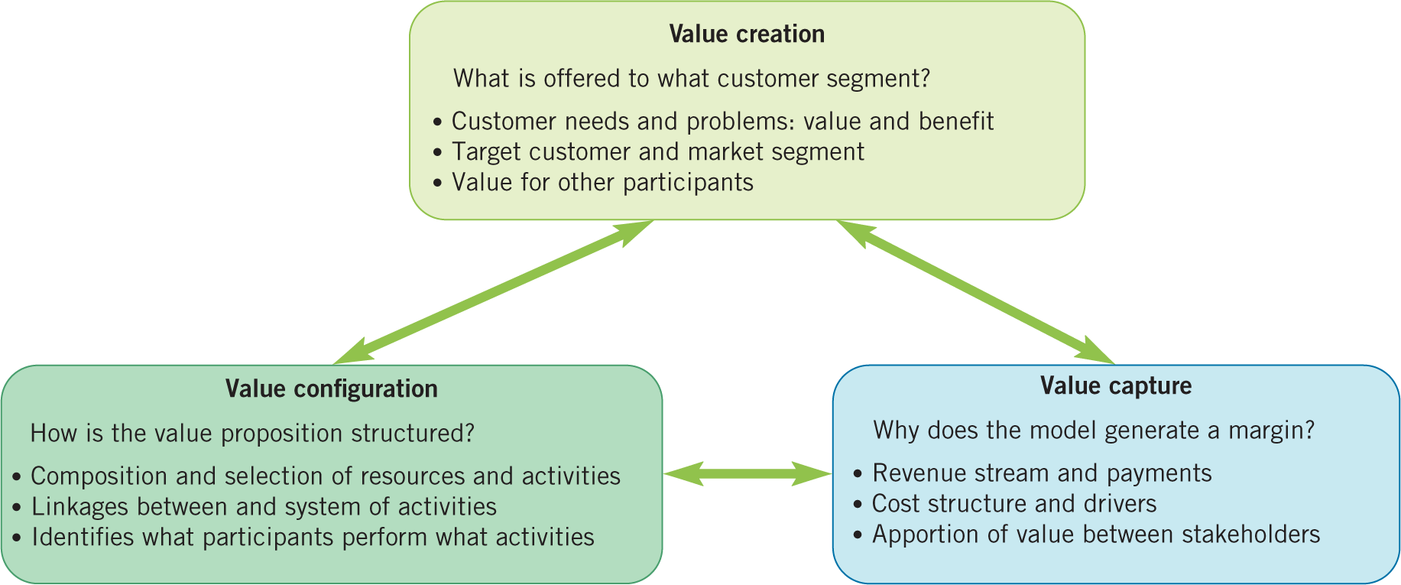
Business model components

Slide 23
Business model patterns
Three typical business model patterns are:
Razor and blade – named after the classic Gillette strategy of selling razors cheaply and profiting from sales of high priced blades (e.g. inkjet printers, single use pod coffee machines, electric toothbrushes).
Freemium – named by combining ‘free’ and ‘premium’. Basic services are free to attract customers who then upgrade to expensive premium services (e.g. Spotify).
Peer-to-peer – brings together people and/or businesses without having to go through a middle man (e.g. Kiva, Zipcar)
Notes:
Business models are the blueprint for how organizations operate and create value. While there are many different ways businesses can structure their models, some patterns are particularly prevalent across industries. Three notable and impactful business model patterns include the Razor and Blade, Freemium, and Peer-to-Peer models. Each of these models leverages unique strategies to generate revenue and grow market share.
1. Razor and Blade Model
Overview: The razor and blade business model is named after the famous Gillette strategy of selling razors at a low price (or even giving them away) while making substantial profits from the sale of razor blades, which are required for the razor to function. This model is based on the idea of selling a product at a low initial cost but generating ongoing revenue from related consumables or accessories that customers need to keep buying over time.
Examples:
Inkjet Printers: Companies like HP or Canon often sell printers at relatively low prices but make significant profits from the ink cartridges that customers must continuously purchase. Ink cartridges tend to be expensive and are a crucial part of the printer's functionality.
Single-use Pod Coffee Machines: Brands like Nespresso or Keurig use this model by selling coffee machines at an affordable price while profiting from the sale of proprietary coffee pods or capsules, which consumers need to buy regularly.
Electric Toothbrushes: Companies such as Philips Sonicare and Oral-B sell electric toothbrushes at a moderate price and earn revenue from the ongoing need for replacement brush heads.
Benefits:
Recurring Revenue: The continuous need for consumables creates a predictable revenue stream over time, making it easier to forecast and plan financially.
Customer Lock-in: Once customers purchase the initial low-cost item (e.g., a razor or printer), they are incentivized to keep purchasing from the same brand due to the need for compatible refills or accessories.
Challenges:
Customer Acquisition: While the low initial price point helps attract customers, the success of the business model depends on convincing customers to keep buying the consumables.
Price Sensitivity: If the consumables are priced too high, customers may look for cheaper alternatives, causing potential loss of loyalty or brand-switching.
2. Freemium Model
Overview: The freemium business model is based on offering basic services or products for free, with the option for customers to upgrade to a premium version with enhanced features, functionality, or benefits. The goal is to attract a large base of free users and then convert a percentage of them into paying customers.
Examples:
Spotify: Spotify offers a free, ad-supported version of its music streaming service, allowing users to listen to music without paying. However, users can opt for a premium subscription, which provides additional benefits such as offline listening, no ads, and higher-quality sound.
LinkedIn: LinkedIn provides free basic services like networking, profile building, and job searching. To access premium features like InMail (sending messages to people outside your network), advanced search filters, and career insights, users need to upgrade to a premium account.
Dropbox: Dropbox offers a free cloud storage service with limited space, encouraging users to upgrade to a paid plan for more storage, better collaboration features, and additional security options.
Benefits:
Large User Base: Offering a free service attracts a wide range of users, which can increase brand awareness and market penetration.
Low Barriers to Entry: Users can easily try the service without any upfront financial commitment, which often leads to higher user acquisition.
Scalability: With a large pool of free users, the conversion to premium plans can lead to significant revenue growth, especially if the business offers valuable premium features that users are willing to pay for.
Challenges:
Conversion Rate: The primary challenge of the freemium model is converting free users into paying customers. Most users will continue using the free version without ever upgrading, making it difficult to generate substantial revenue from them.
Sustainability: For freemium models to be profitable, the premium version must offer enough value that users are willing to pay for it, and the free users' costs (e.g., servers, customer support) must be covered without draining resources.
3. Peer-to-Peer Model
Overview: The peer-to-peer (P2P) business model facilitates direct transactions or exchanges between individuals (or businesses) without the need for a traditional middleman or intermediary. This model leverages technology to connect people and enable them to engage in various activities such as sharing, renting, or selling goods and services to one another.
Examples:
Kiva: Kiva is a nonprofit organization that allows people to lend money directly to low-income entrepreneurs in developing countries, bypassing traditional financial institutions. This peer-to-peer lending model enables individuals to provide capital to small businesses in need.
Zipcar: Zipcar operates as a car-sharing service that connects car owners (or the company itself) with individuals who need a car for short-term use. Instead of owning a vehicle, users can rent cars by the hour or day, which can be a more convenient and cost-effective option for urban dwellers who don’t need a car full-time.
Airbnb: Airbnb is a leading example of a peer-to-peer business model that allows homeowners to rent out their property to travelers, effectively creating a global marketplace for short-term lodging. Hosts and guests engage directly through the platform without the need for traditional hotel chains or real estate intermediaries.
Benefits:
Cost Efficiency: By eliminating intermediaries, peer-to-peer platforms can often offer lower prices to consumers and higher earnings for suppliers.
Scalability: These platforms can grow rapidly because they leverage the existing resources of individuals (e.g., cars, homes, or money), which allows for quick expansion without the company needing to own or manage physical assets.
User Empowerment: Users of P2P platforms often have more control over their experiences—whether they’re setting their own prices, choosing their own terms, or having access to personalized services.
Challenges:
Trust and Security: The success of the P2P model depends heavily on building trust between users. Platforms need to implement systems to ensure that transactions are secure and that users feel confident in interacting with strangers.
Regulation: Some P2P businesses, particularly in areas like accommodation (e.g., Airbnb) or transportation (e.g., Uber), can face legal challenges and regulatory scrutiny from governments and local authorities, especially if they disrupt established industries.
Conclusion
Each of these business model patterns—Razor and Blade, Freemium, and Peer-to-Peer—offers unique ways for businesses to create value and generate revenue.
The razor and blade model focuses on attracting customers with a low initial cost and generating ongoing profits from consumables.
The freemium model leverages a large user base by offering free services and converting a small percentage of users to premium services.
The peer-to-peer model eliminates intermediaries and facilitates direct exchanges between individuals or businesses, often relying on technology to enable these transactions.
While these models offer significant opportunities for innovation and growth, they also come with challenges, such as customer conversion, trust-building, and managing recurring revenue. Businesses need to carefully consider which model best aligns with their products, target market, and long-term goals in order to succeed in today’s competitive landscape.

